Slide 1
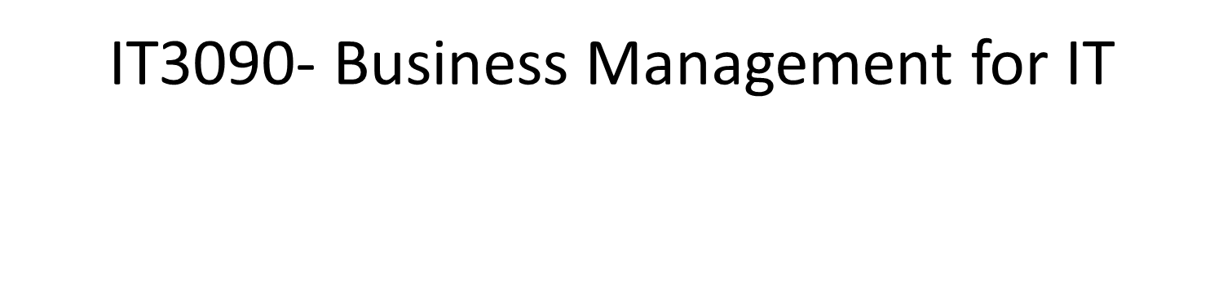
Lecture 03 – Basics of Management (Part 1)
IT3090 - Business Management for IT- Lecture 02 - Ms. Nilmini Rathnayake

Slide 2
Learning Outcomes
At the end of the session students will be able to;
Definitions of management
Management Functions
Planning
Vision
Mission
Goals
Objectives
Organizing
IT3090 - Business Management for IT- Lecture 02 - Ms. Nilmini Rathnayake

Slide 3
What Is Management?
The attainment of organisational goals in an effective and efficient manner through planning, organizing, leading and controlling organizational resources (Daft, 2012).
Management is the process of planning, organizing, leading and controlling the efforts of organization members and of using all other organizational resources to achieve organizational goals (Stoner and Freeman,2009).
IT3090 - Business Management for IT- Lecture 02 - Ms. Nilmini Rathnayake

Slide 4
What Is Management? (Cont’d…)
Applies to and through any kind of organization
Applies to Managers at all levels
Concerned with “Doing the right things right at all times”:
Effectiveness: Achievement of objectives. (Right Things); Attaining organizational goals
Efficiency: Achieving those objectives with least amount/ sacrifice of resources.(Things Right); Getting the most output for the least inputs
IT3090 - Business Management for IT- Lecture 02 - Ms. Nilmini Rathnayake

Slide 5
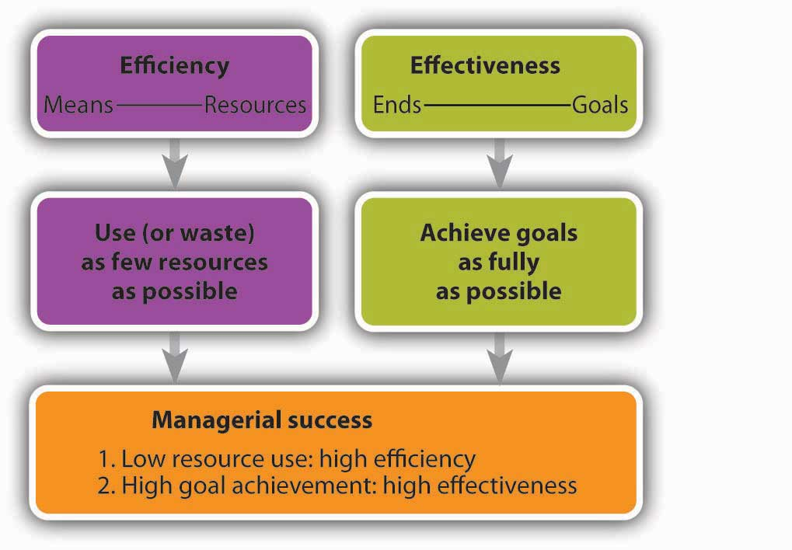
Effectiveness and Efficiency
IT3090 - Business Management for IT- Lecture 02 - Ms. Nilmini Rathnayake

Slide 6
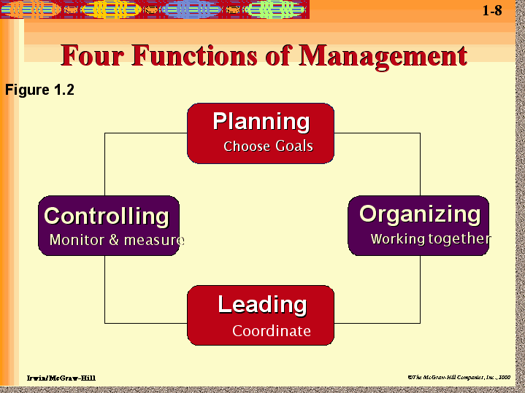
Management Functions
IT3090 - Business Management for IT- Lecture 02 - Ms. Nilmini Rathnayake

Slide 7

Planning
Management Functions
What is the basic economic problem ?
IT3090 - Business Management for IT- Lecture 02 - Ms. Nilmini Rathnayake

Slide 8
Planning (Cont’d…)
e.g
What is the sales target for next year ?
When will be the next product launch?
Should we open a new branch? When? How?
Planning :Setting organizational goals and how best to achieve it
Planning act as a guidance for future
IT3090 - Business Management for IT- Lecture 02 - Ms. Nilmini Rathnayake

Slide 9
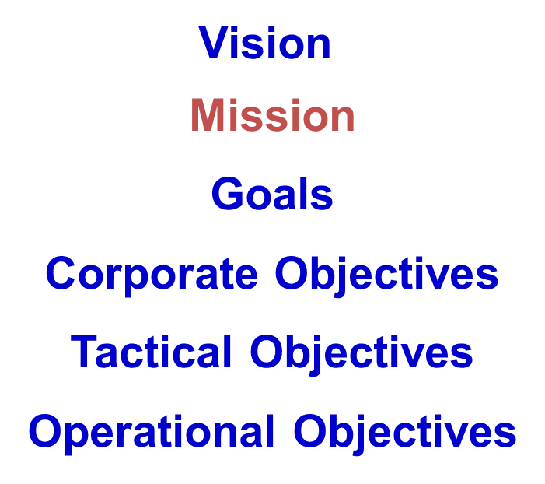
Hierarchy of Aims
Decide where the organization should be in X years of time
IT3090 - Business Management for IT- Lecture 02 - Ms. Nilmini Rathnayake

Slide 10
What is a “Vision” ? (Cont’d…)
Vision is the all inclusive general goal towards which the entire organizational efforts and resources are directed.
It is the vivid aspiration or the ultimate aim that the entire organization hopes to realize in the very long future.
Vision describe in vague terms what the type of organization it wishes to build in the very long future.
IT3090 - Business Management for IT- Lecture 02 - Ms. Nilmini Rathnayake

Slide 11
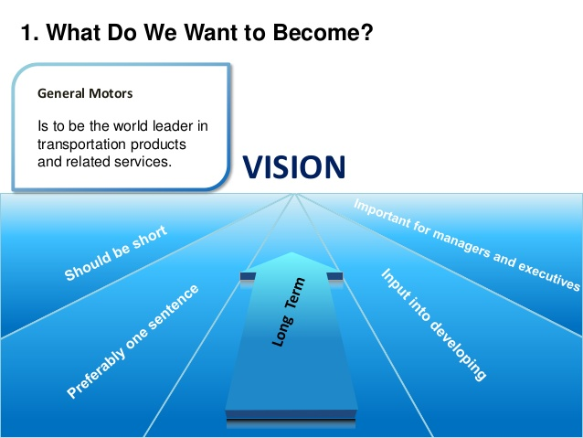
What is a “Vision” ?
IT3090 - Business Management for IT- Lecture 02 - Ms. Nilmini Rathnayake

Slide 12

"All Sri Lankans seamlessly connected with world-class information, communication and entertainment services."
Vision – Sri Lanka Telecom
IT3090 - Business Management for IT- Lecture 02 - Ms. Nilmini Rathnayake

Slide 13
What is a “Mission” ?
Definition of a business in its scope and philosophy
The fundamental, unique purpose that sets a business apart from other firms of its types and identifies the scope of its operations in product and market terms.
IT3090 - Business Management for IT- Lecture 02 - Ms. Nilmini Rathnayake

Slide 14
Mission – Sri Lanka Telecom
"Your trusted and proven partner for innovative and exciting communication experiences delivered with passion, quality and commitment"
IT3090 - Business Management for IT- Lecture 02 - Ms. Nilmini Rathnayake

Slide 15

Goal
General statements of future aims which represent the main core areas of the mission of an organization.
IT3090 - Business Management for IT- Lecture 02 - Ms. Nilmini Rathnayake

Slide 16
Objectives
What is intended to achieve within a defined medium to short period of time
Expected measurable end results or aims of action
IT3090 - Business Management for IT- Lecture 02 - Ms. Nilmini Rathnayake

Slide 17
Characteristics of Objectives
Specific
Measurable
Achievable
Rational/Related
Time Bound
Objectives should be SMART
IT3090 - Business Management for IT- Lecture 02 - Ms. Nilmini Rathnayake

Slide 18
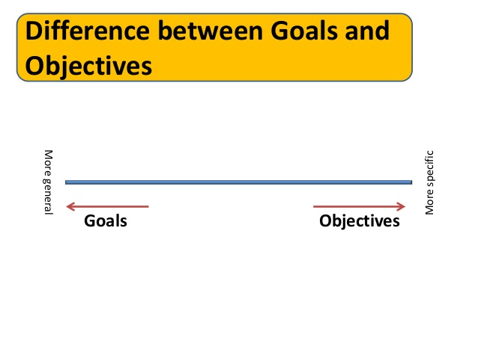
IT3090 - Business Management for IT- Lecture 02 - Ms. Nilmini Rathnayake

Slide 19

Organizing
Management Functions
What is the basic economic problem ?
IT3090 - Business Management for IT- Lecture 02 - Ms. Nilmini Rathnayake

Slide 20
Organizing (Cont’d…)
Organizing is coordinating activities and resources
Organize people and other resources necessary to carry out the set goals
Tasks, jobs, positions, duties and responsibilities can be summarized in to the organizational structure
e.g.
How many employees needed to achieve the expected sales target?
Who will be responsible to carry out promotions?
How much funds required for advertising campaign?
IT3090 - Business Management for IT- Lecture 02 - Ms. Nilmini Rathnayake

Slide 21

IT3090 - Business Management for IT- Lecture 02 - Ms. Nilmini Rathnayake

